Slide 1
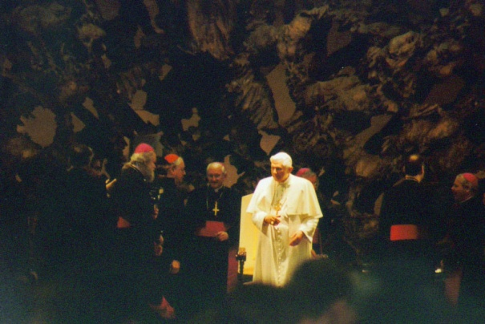
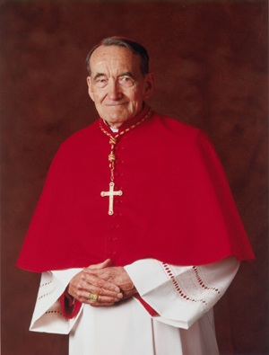
Models of the Church
Avery Cardinal Dulles, S.J.
Notes:
Ecclesiology- from Greek ekklesia – those who are “called out” to form a community.

Slide 2
Avery Cardinal Dulles, S.J.
Models of Church
Institution
Mystical Communion
Sacrament
Herald
Servant
Notes:
Cardinal Avery Dulles wrote a book that became very popular in helping us understand the qualities of the Church. Clearly, some people are comfortable in one form of church rather than another. His Models of Church help us see varying ways church is understood, i.e., what a church “does”, “is”, etc...
Important to note: Dulles did not intend this work to be seen as containing five individual models to be selected according to one’s personal preference. His own private correspondence reveals he saw such a viewpoint as reducing ecclesiology to relativism. Rather, he intended the book as a long plea for partisans of different models to recognize the limitations of the models on which they operated and to open their minds to the values in other models. In short, all of these marks should be part of any church in varying degrees.

Slide 3
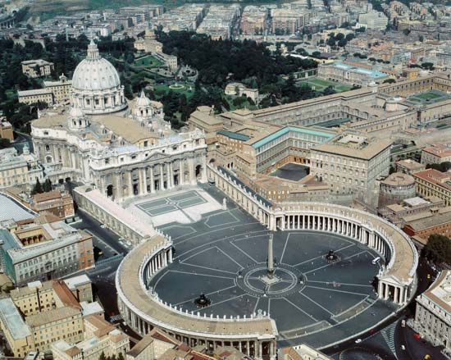
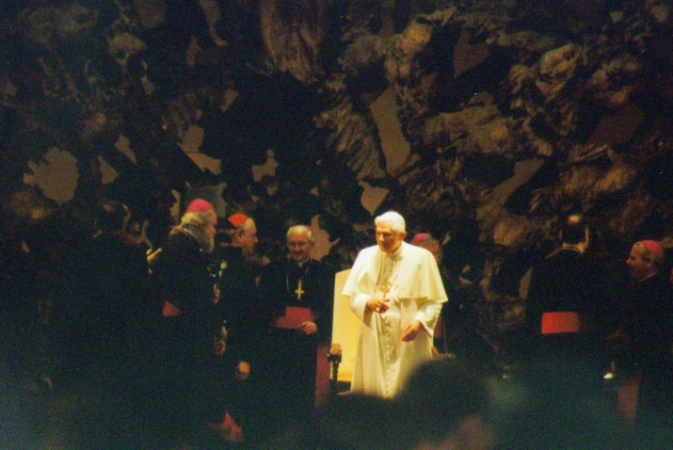
Church as Institution
http://www.vatican.va/phome_en.htm
Notes:
Church as an Institution
The idea of an institutional church provides the structure for organization in which the teachings of Jesus can continue.
The following slides give some insight into the governance of the institution, its structure and leadership.
Roman Catholicism is built on the structure of Rome in the first centuries.
Go to the Vatican web site to appreciate all the work that emanates from there.

Slide 4
The Vatican Curia
The
Pope
Cardinals
Doctrine
Worship
Evangeli-zation
Clergy
Religious
Life
Oriental
Churches
Secretary
Of
State
Dialogue
Tribunal
Education
http://www.vatican.va/phome_en.htm
Notes:
The Pope is surrounded by and assisted by Offices called the “curia.” Each office is responsible for their area of expertise, and each office is made up of both clergy and lay people with expertise, knowledge and experience in their fields of ministry and practice.
Curia: from a medieval court of justice; find the Curia on the Vatican web site.

Slide 5
Theologians
Laity
“sensus fidelium”
Curia
The Pope
Notes:
In addition to his Curia the Pope is surrounded by the Cardinals: men chosen by him to function as his advisory cabinet.
When read in the newspaper that the “Pope said,” more often than not he did not say it but one of his offices published their findings with his knowledge and approval.
In making policy and decisions, advice is sought through local bishops from the laity, that is, those not ordained ministers and from theologians.

Slide 6
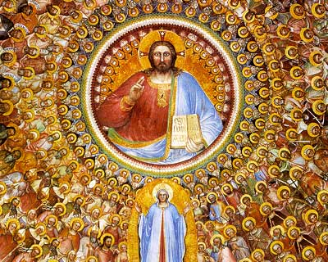
Church as Mystical Communion
Notes:
Church as Mystical Communion
Read 1 Cor. 12:1-31. Here Paul illustrates what is meant by a body of believers united by one spirit of belief.
In this view, the church consists of people of faith who are united by their common participation in God’s Spirit through Christ.
The ties that bind are not primarily institutional but rather pneumatological (spiritual), communal, and personal.
The Church, from this point of view, is not in the first instance an institution or a visibly organized society.
Rather it is a communion of people, primarily interior but also expressed by external bonds of creed, worship, and ecclesiastical fellowship.
The experience of ecclesiastical community differs from any other community in that it has both a horizontal and vertical dimension.

Slide 7
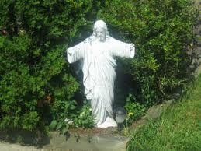
Christ has no body but yours,
No hands, no feet on earth but yours, Yours are the eyes with which he looks Compassion on this world, Yours are the feet with which he walks to do good, Yours are the hands, with which he blesses all the world. Yours are the hands, yours are the feet, Yours are the eyes, you are his body. Christ has no body now but yours, No hands, no feet on earth but yours, Yours are the eyes with which he looks compassion on this world. Christ has no body now on earth but yours.
Notes:
Soldiers in France came upon this statue and one wrote the first lines of St. Theresa's poem on a sign and left it there.
This poem illustrates for us the sense of being the “body of Christ” now on earth, after Jesus is no longer here.

Slide 8
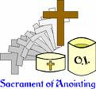
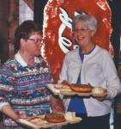
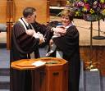
Church as Sacrament
Notes:
Church as Sacrament
In this model, the church makes present that which is other.
This model emphasizes the mystical way the presence of Christ is made present through the people of God through prayer, liturgy, and acts of charity.
Sacrament comes from the from Latin sacramentum. The Latin term was used to translate the Greek term mustērion, meaning “mystery.”
Roman Catholics celebrate key moments and events on their life-journey where they both desire and sense the presence of God in their lives.

Slide 9
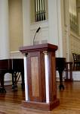
Church as Herald
Notes:
Church as Herald
The church is called to preach the Word of God, both within its gathering and outside of it, just as Jesus did.
In the Catholic Church, the Mass is equally divided between the Liturgy of the Word and the Liturgy of the Eucharist. The Liturgy of the Word is where the focus is on the Bible, its reading of passages from the Old and New Testament and the Gospels read in a three year rotation, with a reflection or “homily” on the passages of the day.
In Protestant Churches, generally the whole service is focused on the Bible, its reading, reflection on the passages in a much longer sermon and in the hymns which are in reality the singing of what they believe or their “theology.”

Slide 10
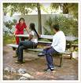
Church as Servant
Notes:
Church as Servant
The ministry of Jesus, the suffering servant of God who was “a man for others,” provides the template for this model.
Just as Christ came into the world not to be served but to serve, so the Church, carrying on the mission of Christ, seeks to serve the world by fostering the brotherhood of all men. As the Lord was the man for others, so the Church ought to be the community for others.”
In the Catholic Church, the liturgy on Holy Thursday recalls this call to service made by Jesus at his last supper with his disciples. The gospel read on this day is John 13:1-20, which tells the story of how Jesus took on the role of a servant who would wash the dirty feet of guests, then telling the disciples to go and do likewise.

Slide 11
The
Pope
&
Bishops
North America
South America
Africa
Europe
Asia
Australia
Antarctica
Notes:
It is important to realize that the Catholic Church is universal, that it is world-wide!!! For this reason it moves slowly and consciously.

Slide 12
Archbishop
of Newark
Laity
Diocesan
Offices
Priests
Hospitals
Parishes
Other
Ministries
Schools
Colleges
Notes:
The world is divided into continents, and then into countries and then each country into state and then states into counties, etc... It is the same with the Church. So, in New Jersey the Roman Catholic Church is divided into five sections called dioceses. Each diocese is under the care of a bishop who is answerable to the Pope in Rome. Each bishop is called to Rome every five years to report on his diocese and his people in it.
In large metropolitan areas with a large concentration of people the diocese is called an Archdiocese and the bishop an archbishop who usually has a few auxiliary bishops to help him. So, Caldwell University is in the Archdiocese of Newark along with the bishops of Exxex County, Hudson County, Bergen County, and Union County.
The slide above represents all the agencies and institutions the bishops are responsible for under the Archbishop of Newark.

Slide 13
African American, African and Caribbean Apostolate Archbishop's Office Sharing God’s Blessing Annual Appeal Catechetical Office The Catholic Advocate Catholic Cemeteries Child and Youth Protection Clergy Personnel Christian Foundations for Ministry Communications and Public Relations Delegate for Religious The Office of Development and Stewardship Education Office for Evangelization Family Life / Pastoral Familiar Hispana Hispanic Apostolate History and Archives Human Concerns Human Resources Information Technology | Parish and School Resources Men's Commission Metropolitan Tribunal Ministry with Persons with Disabilities Ministry with the Deaf New Energies Parish Transition Project New Jersey Catholic Parish and School Business Services Permanent Diaconate Pontifical Mission Socities Property Management Administration Research and Planning Respect Life Vocations for Diocesan Priesthood Vocations for Religious Life Women's Commission Worship, Office of Divine Youth and Young Adult Ministry
Notes:
Archdiocese of Newark.
This list represents all the agencies in our Archdiocese. These agencies are supported by donations from all the local parishes and serve them when needed.

