Slide 1
Bachelor project kick-off Autumn 2017

Slide 2
Agenda
Requirements for the bachelor project
Structure of the bachelor report
Counsellors & Group status

Slide 3
Important dates
Bachelor project start 1. November
Bachelor project hand-in 3. January 2018 *
Bachelor project exam 22. – 24. January
Bachelor graduation You’ll receive information from the reception at your school mail
Electronic hand-in in WISEflow

Slide 4
Bachelor project – Central points from the curriculum
The education is finished by a bachelor project
The project can be in groups of up to three students
The project is TYPICALLY conducted in cooperation with a company
It is your counsellor who approves the problem formulation
The project must address central parts of the program
The scope of the project must MAXIMUM be 40 pages + no of students * 20
The assessment is primarily based on your work (the report)

Slide 5
Bachelor project – Differences from computer science project
Higher professional level
The central PBA topics must constitute the main problem (one or more)
systems integration
Test
contract based development
large systems development
Higher level of generality
Reflections in the project must be more general - i.e. less personal and of more og interest for the profession

Slide 6
Theory in the Bachelor project
Do not forget the P in Professional bachelor
Practical issues, preferably in a company
The project must demonstrate the you
Are ”ready” (the project is your masterpiece)
Can contribute to the development of the profession by generalising your experience ( the project becomes a ”show case”)

Slide 7
The report
Product report (~50 %)
Delivery to the commissioner, that
Documents a developed system
Document a solution to a problem (i.e. usage of standards for integration)
Recommendations for usage of technology (i.e. a comparative analysis of different technologies) …
Process report (typically max. 25 %)
Delivery to the assessors, describing how the solution is produced focusing on documenting professional conduct of work
Documentation of a structured and systematic approach to problem solving
Be able to show the underlying rationale behind decision making
Theory report (25 % or more)
Delivery to the profession, describing how the issues can be considered ad a field study / a case handling generic problems
Evaluation of method and work
Emphasizing of relevant topics
Assessment of technologies …

Slide 8
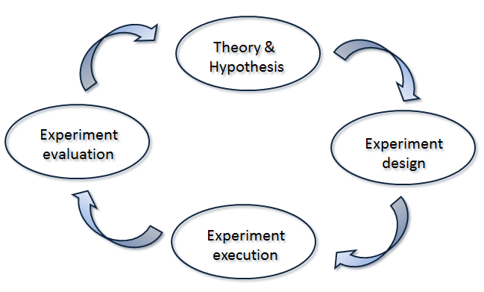
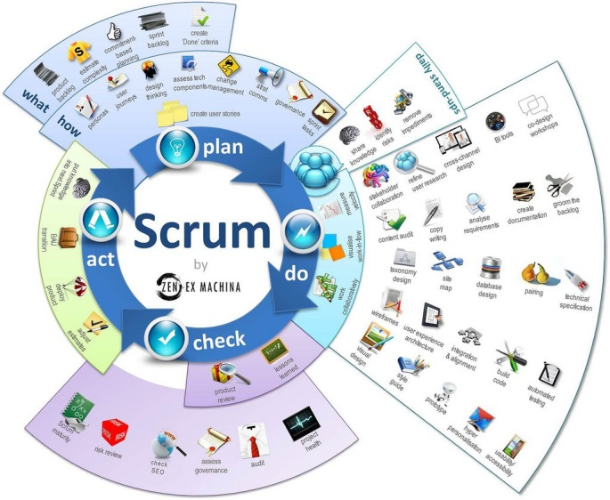
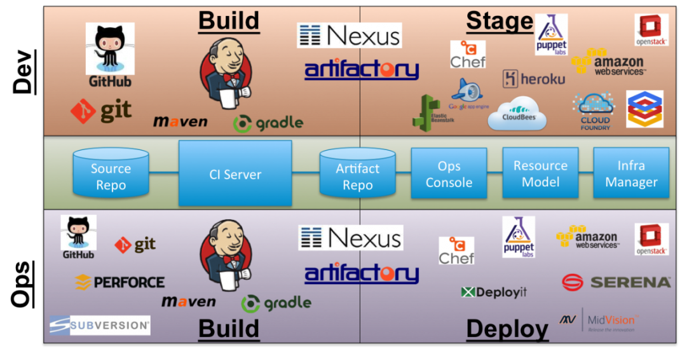
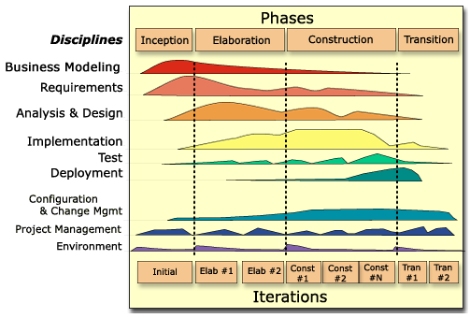
Process report - a systematic and structured approach
vs.

Slide 9
Theory report
Generalised subset of topics from product and process report relevant to others in the profession
Target group: Your fellow students or coming students at the program
Product report
Process-report
Theory-report

Slide 10
The theory report (a generalisation)
 | Problem | Solution
Theory (generic/abstract) | Theoretical problem From core subjects in the program Generalise your practical problems! | Theoretical solution How can you generalise your solution in a way it becomes relevant for others in the profession? Generalise your concrete solutions so they become relevant for others!
Practise (specific/concrete) | Practical problem Which theoretical problems did you encounter as concrete problems in your project? Exemplify theoretical problems! | Practical solutions How did you solve these problems in your project? Convey concrete solutions to theoretical problems!

Slide 11
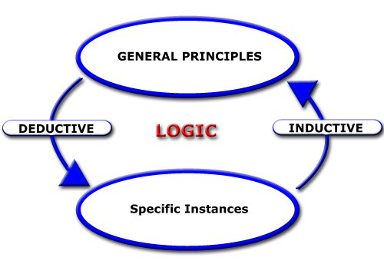
Induction and deduction

Slide 12
The counselling
The counsellors will NOT correct, but lead the way i.e.
Evaluate
Provide critique
Counsellor meeting are dialogue meeting

Slide 13
Counsellors
Counsellors
Kasper Østerbye koe@cphbusiness.dk
Tine Marbjerg tm@cphbusiness.dk
Caroline Hundahl chu@cphbusiness.dk
Rolf Helge Pfeiffer rhp@cphbusiness.dk
Claus Terp claus.terp@mail.com
Counsellor resources
Approx. 1 hour pr. week pr. group
One-man group have less

