Slide 1
Intelligence-Led Policing and the Intelligence Cycle

Slide 2
What is Intelligence?
Intelligence is processed information: tiny bits of information are brought together to reveal something larger.
Intelligence should involve informed speculation.
Not just a collection of facts; it should answer the “so what” questions.

Slide 3
What Does it Mean to be Intelligence-Led?
Proactive, not reactive: Anticipate criminal activity in order to
prevent it, rather than react to the criminal activity after it has
become a major problem.
Treats causes of crimes rather than symptoms: Remove the
opportunities for crime rather than relying on arrests.
Coherent, not disjointed: Standardizes and unifies the flow of
information between and within law enforcement agencies.

Slide 4
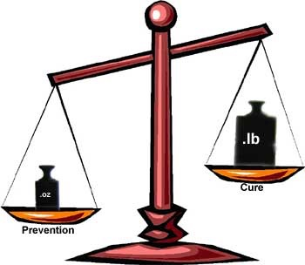
Why Adopt the Intelligence-Led Model?
It’s more effective – it can help lower crime rates

Slide 5
Why Separate Intelligence from Enforcement?
First and foremost because of disclosure: when intelligence is disclosed it can reveal secretive information relating to other matters.
1991 Supreme Court of Canada R v. Stinchcombe ruling stated that the Crown has a duty to disclose all evidence relevant to a case – and the concept of relevance has been interpreted to favour disclosure.
To avoid having secretive police information fall into the hands of the public, intelligence information is protected by several pieces of legislation.

Slide 6
R v. Stinchcombe
R. v. Stinchcombe, [1991] 3 S.C.R. 326 is a landmark Supreme Court of Canada decision on the disclosure of evidence in a trial and is considered by most to be one of the most significant criminal law cases of the decade. The Court found that the Crown had a duty to provide the defence with all evidence that could possibly be relevant to the case, regardless of whether the Crown plans to call that evidence at trial or not, or whether it helps or hurts the Crown's case. This case put to rest the long standing issue of whether the Crown could purposely deny the defence evidence that the Crown found would be harmful to their case.
"The Crown has a legal duty to disclose all relevant information to the defence. The fruits of the investigation which are in its possession are not the property of the Crown for use in securing a conviction but the property of the public to be used to ensure that justice is done.“ CANLII.ca

Slide 7
Assignment
Prepare a 2 page (double spaced) report on R. STINCHCOMBE.
Provide an explanation of this ruling and provide an example.
Utilize APA style for referencing.
Refer to CANLII.ca.
Due Date: Feb 13/14, 2017

Slide 8
Example of Intel-Led Policing
Case Study: Tranquilandia
During the early 1980s a DEA intelligence analyst looked at the rising cocaine problem in the US and came to a startling conclusion…
Not what the DEA knew, but rather what they didn’t know…
Where the chemicals to make cocaine were coming from!

Slide 9
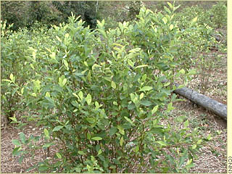
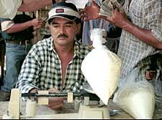
The Cocaine-Making Process
Turning coca leaves into powder cocaine involves ether and acetone…

Slide 10
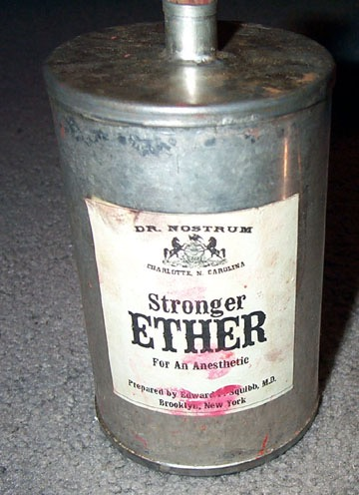
Where are Ether and Acetone Produced?
…And over 90% of ether and acetone was being produced in the US.

Slide 11
DEA Sets the Trap
DEA approached chemical producers to notify them of unusually large future orders of these chemicals.
Tracking bugs were placed on the ether drums.
The signal was traced to a remote part of the Colombian jungle.
With the assistance of Colombian authorities, the DEA conducted a raid on the ether drums coordinates.

Slide 12
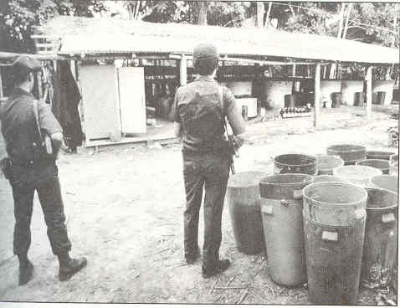
Medellin Cartel
was $1.2 billion
What did they find?
19 cocaine-processing laboratories that containing more than 13.8 metric tons of cocaine
7 planes
11,000 drums of chemicals
A seizure of roughly $1.2 billion
Tranquilandia

Slide 13
The Upshot
Intelligence-Led Policing is all about focusing on what you don’t know.

Slide 14
https://www.youtube.com/watch?v=WtimnditpCE
https://www.youtube.com/watch?v=AQFXNfqpnas

Slide 15
Video
Top Ten Drug Busts
https://www.youtube.com/watch?v=WtimnditpCE
Mexican Drug Lord home
https://www.youtube.com/watch?v=MSF1oIqDAxw
Inside the DEA
https://www.youtube.com/watch?v=Gck0jA1aSho
https://www.youtube.com/watch?v=9I7PPWV1qt0
Mafia’s Secret Bunkers
https://www.youtube.com/watch?v=9I7PPWV1qt0
Camorra Mafia
https://www.youtube.com/watch?v=qcC34VuhxaA
Inside the DEA
https://www.youtube.com/watch?v=wDRKRLgGZWY

Slide 16
Intelligence Officer VS. Investigator
Intel Officer
Gathers raw information
Interviews sources
Develops intelligence
Investigator
Gathers evidence
Interviews witnesses
Develops a case for prosecution
VS.

Slide 17
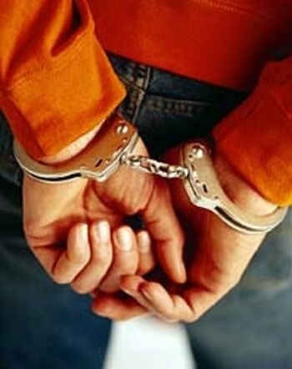
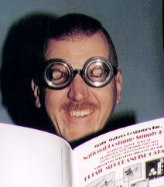
Challenges to Adopting the Intelligence-Led Model
Law enforcement typically wants more of this…
And less of this…

Slide 18
Challenges to Applying the Intelligence-Led Model
Measuring Success
Intelligence works behind the scenes to disrupt problems before they get out of hand.
As a result, successes typically go unnoticed outside of intelligence circles.
Any successes that do result are typically attributed to enforcement.

Slide 19
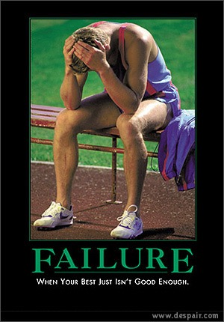
Challenges to Applying the Intelligence-Led Model
Managing Expectations
Intelligence failures can be more common than successes.
Think in terms of baseball batting averages.

Slide 20
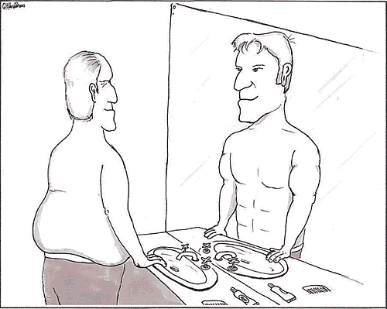
Challenges to Applying the Intelligence-Led Model
Truth to Power
Need to acknowledge personal and institutional biases.
Need to prevent self-serving analysis.
Analysts can face pressure to tell the organization what it wants to hear.

Slide 21
Wheel of Intelligence
Stages:
Direction and Planning
Collection
Processing
Dissemination
DIRECTION AND PLANNING
Deliver
Determine
DISSEMINATION
Plan
Prepare
Select
Task
Consumption
`
Feedback
Integrate
Analyze
Collect
Planning
COLLECTION
PROCESSING
Evaluate
Deliver
Collate
Notes:
The average passer rate for the 2004 NFL season.

Slide 22
Intelligence and Enforcement: the Connection
Dissemination
Disclossure and
Assessment
Arrests
Processing
Intelligence Cycle
Priorities
Operational
Cycle
Direction and Planning
Direction and Planning
Collection
Investigation
Notes:
The average passer rate for the 2004 NFL season.

Slide 23
The Crime Analysis Process (Chapter 4)
Collection
Feedback
Collation
Dissemination
Analysis

Slide 24
How Does the Intel Officer Fit into the Wheel (in Theory)?
In theory, Intel Officers should be involved primarily in the Collection phase.
Roles would include:
Source recruitment, handling, and debriefs
Surveillance
Collection of background information through open source, policing contacts, government offices, etc.
Possible involvement in writing intelligence reports.
Disclossure and
Assessment
Arrests
Processing
Direction and Planning
Direction and Planning
Collection
Investigation
Notes:
The average passer rate for the 2004 NFL season.

Slide 25
How Does the Intel Officer Fit into the Wheel (in Practice)?
In practice, the role of Intel Officers varies significantly from police force to police force in Ontario.
Variations include:
Working between investigators (who handle sources) and analysts (who analyze the information).
Functioning in effect as analysts (i.e., involvement in all phases of the intelligence cycle).
Writing intel reports alongside analysts; or writing entirely different kinds of intel reports (i.e., purely factual, non-analytical reports).
Disclossure and
Assessment
Arrests
Processing
Direction and Planning
Direction and Planning
Collection
Investigation
Notes:
The average passer rate for the 2004 NFL season.

Slide 26
Stage 1: Direction and Planning
Take direction from management and define the problem.
Keys:
Narrow the issue to something manageable.
Look for the intelligence gaps.

Slide 27
Stage 2: Collection
Intelligence requirements | Questions | Sources | Responses | …etc.
Develop a Collection Plan, which can include:
Intelligence requirements
Follow-up questions
Possible sources
Tracking of responses

Slide 28
Collection Plan
Develop a Collection Plan.

Slide 29
Stage 3: Analysis
Strategic
Trends and emerging issues
Operational
Criminal networks and organized crime genres
Tactical
Criminals and criminal organizations
Crime
Temporal and spatial crime patterns
STRATEGIC
ANALYSIS
Long-term Value
OPERATIONAL ANALYSIS
TACTICAL ANALYSIS
CRIME ANALYSIS
Notes:
The average passer rate for the 2004 NFL season.

Slide 30
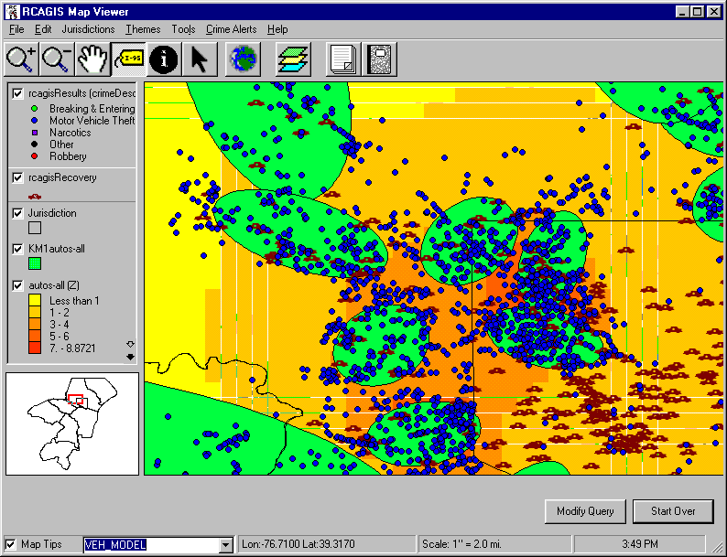
Crime Analysis
Focus on spatial and temporal crime patterns
TOOLS OF THE TRADE
Hotspot analysis
Event timelines

Slide 31
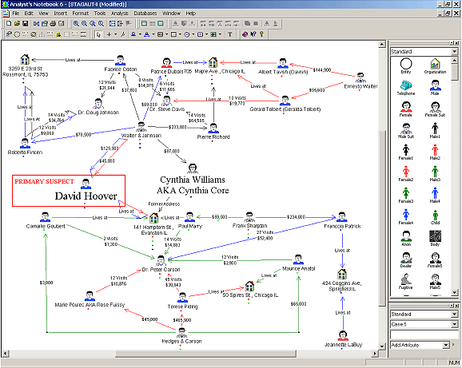
Tactical Analysis
Focus on specific criminals, their immediate criminal clique, and their immediate criminal operations. Supports a single investigation or file.
TOOLS OF THE TRADE
Link charts
Telephone toll analysis
Facial recognition software

Slide 32
Operational Analysis
Outlaw Motorcycle Gangs (OMGs)
Street Gangs (SGs)
Eastern European Organized Crime (EEOC)
Traditional Organized Crime (TOC)
Middle Eastern Organized Crime (MEOC)
Asian Organized Crime (AOC)
First Nations Organized Crime (FNOC)
Non-Traditional Organized Crime (NTOC)
Criminal Extremism (CRIMEX)
Foreign Terrorist Organizations (FTOs)

Slide 33
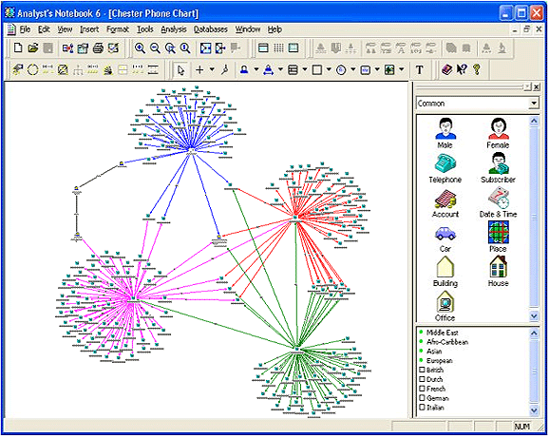
Operational Analysis
Focus on a broader set of criminals, their criminal organizations and network, and their broader criminal operations. Can assist in target selection.
2
TOOLS OF THE TRADE
SLEIPNIR scale
Harm scale
Social Network Analysis

Slide 34
Video
i2
https://www.youtube.com/watch?v=1gpaqOJV-Cw

Slide 35
timely topical tangible

Slide 36
Harm Scale
A Counterpart to Sleipnir: will measure ‘harm’ as opposed to ‘sophistication’ of crime groups.
Will be based on Statistics Canada’s Crime Severity Index.

Slide 37
Social Network Analysis
Social network analysis [SNA] is the mapping and measuring of relationships and flows between people, groups, organizations, computers, URLs, and other connected information/knowledge entities. The nodes in the network are the people and groups while the links show relationships or flows between the nodes.

Slide 38
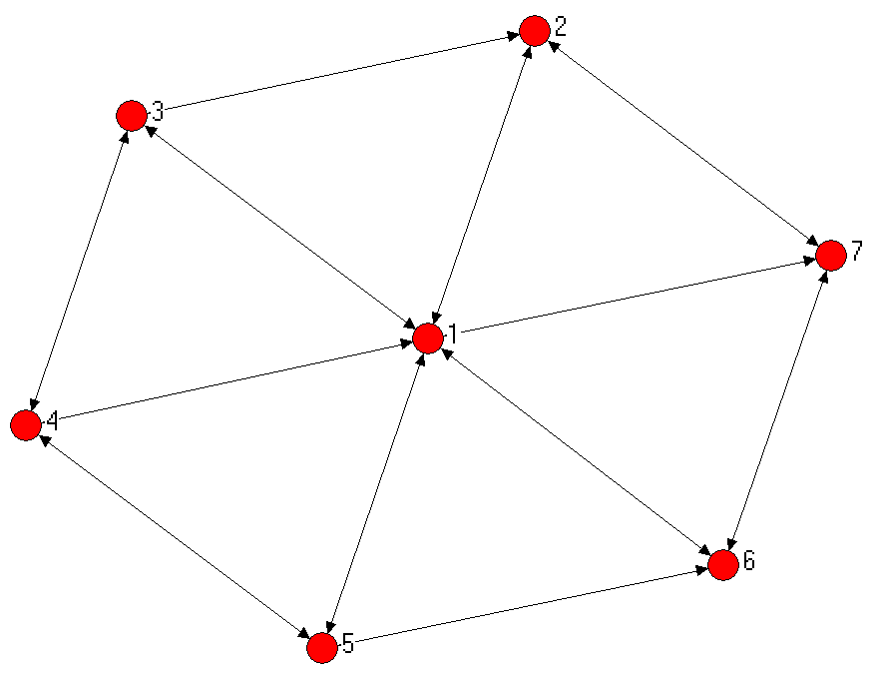
Social Network Analysis
Centrality is a core concept in SNA: within a network, the most central actor(s) are often the most interesting because they are in a better position to disseminate information and goods.
Centrality can sometime be determined by eye.

Slide 39
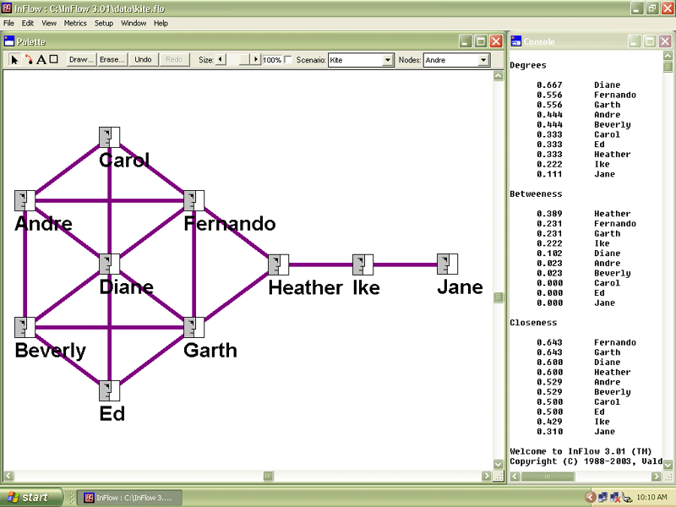

Slide 40
SNA – Degree Centrality
Degree Centrality
Social network researchers measure network activity for a node by using the concept of degrees -- the number of direct connections a node has.
In the kite network above, Diane has the most direct connections in the network, making hers the most active node in the network.
She is a 'connector' or 'hub' in this network.
Common wisdom in personal networks is "the more connections, the better." This is not always so. What really matters is where those connections lead to -- and how they connect the otherwise unconnected! Here Diane has connections only to others in her immediate cluster -- her clique. She connects only those who are already connected to each other.

Slide 41
SNA - Betweenness Centrality
While Diane has many direct ties, Heather has few direct connections -- fewer than the average in the network.
Yet, in may ways, she has one of the best locations in the network -- she is between two important constituencies.
She plays a 'broker' role in the network. The good news is that she plays a powerful role in the network, the bad news is that she is a single point of failure. Without her, Ike and Jane would be cut off from information and knowledge in Diane's cluster.
A node with high betweenness has great influence over what flows -- and does not -- in the network. Heather may control the outcomes in a network. That is why "As in Real Estate, the golden rule of networks is: Location, Location, Location."

Slide 42
SNA - Closeness
Closeness Centrality
Fernando and Garth have fewer connections than Diane, yet the pattern of their direct and indirect ties allow them to access all the nodes in the network more quickly than anyone else.
They have the shortest paths to all others -- they are close to everyone else.
They are in an excellent position to monitor the information flow in the network -- they have the best visibility into what is happening in the network.

Slide 43
SNA – Network Centralization
Individual network centralities provide insight into the individual's location in the network.
The relationship between the centralities of all nodes can reveal much about the overall network structure.
A very centralized network is dominated by one or a few very central nodes.
If these nodes are removed or damaged, the network quickly fragments into unconnected sub-networks.
A highly central node can become a single point of failure. A network centralized around a well connected hub can fail abruptly if that hub is disabled or removed. Hubs are nodes with high degree and betweeness centrality.
A less centralized network has no single points of failure. It is resilient in the face of many intentional attacks or random failures -- many nodes or links can fail while allowing the remaining nodes to still reach each other over other network paths. Networks of low centralization fail gracefully.

Slide 44
SNA – Boundary Spanners
Nodes that connect their group to others usually end up with high network metrics.
Boundary spanners such as Fernando, Garth, and Heather are more central in the overall network than their immediate neighbors whose connections are only local, within their immediate cluster.
You can be a boundary spanner via your bridging connections to other clusters or via your concurrent membership in overlapping groups.
Boundary spanners are well-positioned to be innovators, since they have access to ideas and information flowing in other clusters.
They are in a position to combine different ideas and knowledge, found in various places, into new products and services.

Slide 45
SNA – Peripheral Players
Most people would view the nodes on the periphery of a network as not being very important.
In fact, Ike and Jane receive very low centrality scores for this network.
Since individuals' networks overlap, peripheral nodes are connected to networks that are not currently mapped.
Ike and Jane may be contractors or vendors that have their own network outside of the company -- making them very important resources for fresh information not available inside the company!

Slide 46
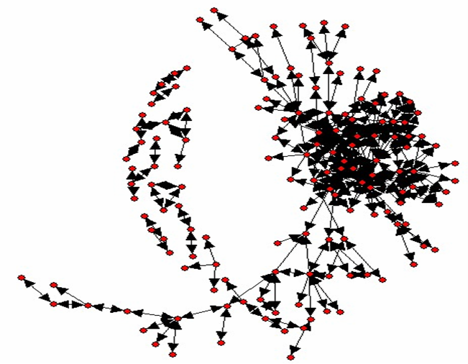
Social Network Analysis
PROVINCIAL
NETWORK
(2007)

Slide 47
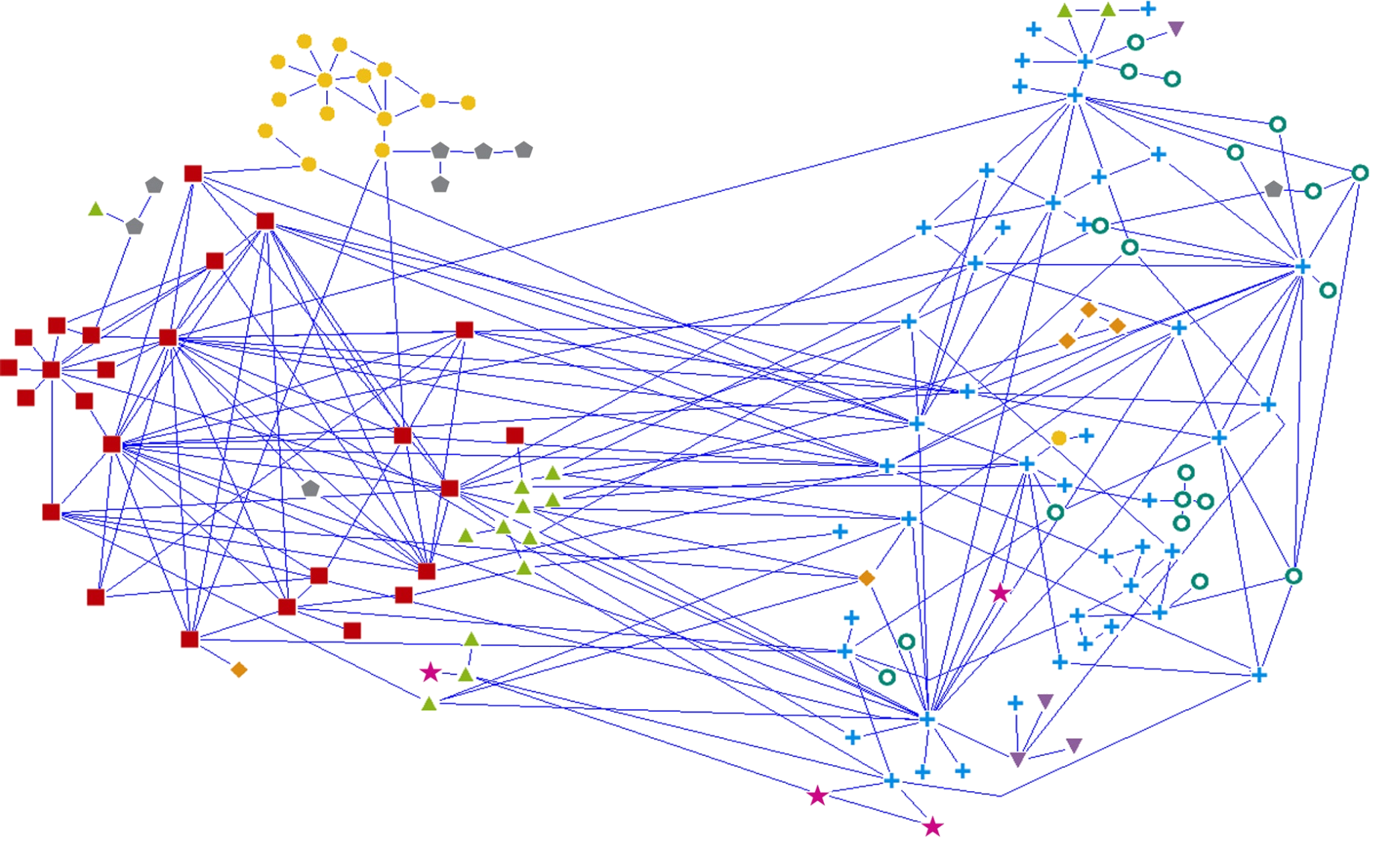
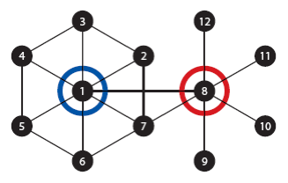
How Threat is Gauged: Social Network Analysis
Asian Organized Crime
Criminal Extremist Group
Eastern European Organized Crime
First Nations Organized Crime
Middle Eastern Organized Crime
Non-Traditional Organized Crime
Outlaw Motorcycle Gang
Street Gang
Traditional Organized Crime

Slide 48
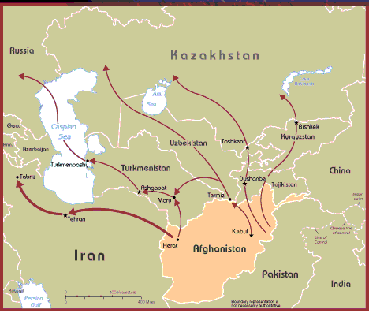
Strategic Analysis
Focus on criminal landscape: crime trends, and emerging domestic and international issues.
TOOLS OF THE TRADE
Statistical software
Newswire services

Slide 49
Strategic Analysis
Strategic analysis is “development driven.”
That is, it monitors domestic and international developments and trends and look for their implications for Ontario’s criminal landscape.
Two basic scenarios: Developments and trends either create new opportunities for organized crime in Ontario, or limit existing opportunities.
Intel officers should pay attention to these red flags, look for indicators in the field, and report back information to Intel Analysts.

Slide 50
Strategic Analysis: Examples of Trends and Developments
Examples:
Crime (e.g., mephedrone/bath salts in the UK)
Political (e.g., OC crack-downs in China and Italy)
Legal (e.g., prostitution ruling)
Legislative (e.g., medicinal marihuana)
Technological (e.g., new auto theft technologies)
Economic (e.g., metal prices)

Slide 51
Testing Theories
FALSIFICATION
OBSERVABLE IMPLICATIONS
Try to prove your theory wrong.
Try alternative theories.
The “Argument from Coincidence.”
If your theory is correct, what should you expect to observe?

Slide 52
Stage 4: Dissemination
This is where the value added report is written and sent to appropriate stakeholders.
There is no standardized format for writing intelligence reports in Ontario or Canada. Formats vary between (and within) police agencies.
There are, however, some common elements that most good intelligence reports contain.

Slide 53
Classified Information
Classified information
Classified information relates to the national interest. It concerns the defence and maintenance of the social, political, and economic stability of Canada. There are three levels of classified information:
Top secret: A very limited amount of compromised information could cause exceptionally grave injury to the national interest.
Secret: Compromise could cause serious injury to the national interest.
Confidential: Compromise could cause limited injury to the national interest.
Indoctrination: CSE

Slide 54
Protected Information
Protected information
Protected information refers to specific provisions of the Access to Information Act and the Privacy Act and applies to sensitive personal, private, and business information.
Protected C: Compromise of a very limited amount of information could result in exceptionally grave injury, such as loss of life.
Protected B: Compromise could result in grave injury, such as loss of reputation or competitive advantage.
Protected A: Compromise could result in limited injury.

Slide 55
Security Classifications: Unclassified Reports
Protected A
Low Sensitive - compromise could cause injury
- reveal general area of police interest through media
Protected B
Particularly Sensitive - compromise could cause serious injury
- tip off subject of interest and compromise a specific police investigation
Protected C
Extremely Sensitive - compromise could cause extremely serious injury
- disclosing identity of a UC operator

Slide 56
Security Classifications: Classified Reports
Confidential
Compromise might cause damage to the national security.
For example, a report reveals interest by security officials in a particular issue (e.g., Hawala as a source of terrorist financing).
Secret
Compromise might cause serious damage national security.
- For example, a report reveals interest by security officials in a country suspected to be employing economic espionage.
Top Secret
Compromise might cause exceptionally grave damage national security.
For example, a report reveals details on active investigation into a suspected terrorist group.

Slide 57
Recognize information resources that require formal protection
information resources received in confidence from other governments and organizations-these information resources should be marked as "received in confidence," indicating the source before being distributed to other institutions;
information resources obtained or prepared by a federal investigative body, which assigns the appropriate level of protection-institutions receiving these information resources should give equivalent protection, after consultation with the investigative body;
Cabinet confidences, including information resources prepared to inform or obtain decisions from the Queen's Privy Council of Canada or information resources that reflect Council communications, discussions, deliberations, or decisions-for more information,

Slide 58
Recognize information resources that require formal protection
personal information, which is information about an identifiable individual that is recorded in any form, including information about an individual's race, age, personal address, or medical history-the Privacy Act imposes legal controls on the collection, use, retention, disclosure, and disposal of personal information;
commercial or private business information, which includes trade secrets, confidential information supplied by a third party in confidence, information that could result in financial loss or prejudice someone's competitive position, and information that could interfere with contractual or other negotiations of a third party; and
advice relating to internal decision making that could interfere with institutional operations if disclosed.

Slide 59
Dissemination Restrictions
Unrestricted
The report can be disseminated to law enforcement.
Restricted
The report can be disseminated to designated law enforcement only.
Third Party Rule
The report cannot be disseminated without approval of the author.

Slide 60
Why Change a Security/Dissemination Designation?
The Intelligence-Led approach requires that information flow as freely as possible.
Far too often, security/dissemination classifications are left unchanged, restricting information sharing; old reports should periodically be revisited.
Reasons to alter security/dissemination designations include:
Passage of time
New intelligence
Investigations

Slide 61
Sourcing Information
At the end of each statement, you must identify the source of the information.
If multiple sources are available, indicate “DERIVED FROM MULTIPLE SOURCES” and use an endnote to identify all sources used.
Provide the date of the information.
(TPS File 01-0001)(2001/01/01)
(DERIVED FROM MULTIPLE SOURCES)(2003/10/11)

Slide 62
Reliability Indicators: Common Form
C/R - CONFIRMED RELIABILITY
B/R - BELIEVED RELIABILITY
U/R - UNKNOWN RELIABLIITY
D/R - DOUBTFUL RELIABILITY
/C - AVAILABLE FOR COURT
NB: This is typically added on to the C/R information and written as C/R/C

Slide 63
Reliability Indicators: Alternate Form
Source
A = Completely Reliable
B = Usually Reliable
C = Fairly Reliable
D = Not Usually Reliable
E = Unreliable
F = Reliability Cannot be Judged
Information
1 = Confirmed
2 = Probably True
3 = Possibly True
4 = Doubtfully True
5 = Improbable
6 = Truth Cannot be Judged
Example 1: C1 = A fairly reliable source who has provided information that has been confirmed through at least one other source.
Example 2: A5 = A completely reliable source has provided information that on this occasion is improbable based on other information you’ve received from informants.

Slide 64
Intelligence Report Format
A. Synopsis
B. Entities Identified
C. Facts Regarding the Information
(Security Classification) Information ………
(Source of Information)(Date)(Reliability Indicator)
D. Analytical Comment
Treat as information (i.e. Provide Security Classification)
E. Distribution List
F. Author + Authorizations
G. Endnotes

Slide 65
What Should a Report Convey?
This will depend largely on the report content: no standardization.
If a report deals with an SOI or crime group, the following factors should be considered:
CAPABILITIES: What is the real potential of the entity under observation?
LIMITATIONS: What capabilities have yet to be developed and what are the obstacles to their development?
VULNERABILITIES: Where is the entity weakest?
INTENTIONS: What is the threat posed by the entity and what does it hope to accomplish?

Slide 66
Types of Questions that a Report Should Answer About a SOI/Crime Group Members
Where do they live?
What property do they own?
What vehicles do they own?
What are their personal relationships?
What are their business relationships?
What, if any, is their criminal history?
What locations and events do they frequent?
Where do they do their banking?
What is their financial situation?
Where do they fit into the organization/network?
These types of questions will help determine Capabilities, Limitations, Vulnerabilities, and Intentions.

Slide 67
Identifying Intelligence Gaps
The Analyst Comment section should identify intelligence gaps.
What do we not know about a particular SOI, crime group, event, or development?
What do we need to learn to get a more complete picture?
Identifying intelligence gaps fuels the intelligence cycle: this leads back to the development and planning phase.
Tell them what you know
Tell them what you don’t know
Tell them what you think
Never confuse the three

Slide 68
Disclosure Issues
Intelligence is protected in Canada by several pieces of legislation, but Intel Officers should nonetheless take steps to avoid having their reports required for court disclosure.
One key is to have investigators source specific information from intelligence reports as opposed to sourcing the entire report. For example, if an intelligence report contains information that can be sourced back to a surveillance report, then investigators should be encouraged to cite the specific surveillance report.

Slide 69
TYPES OF CRIME ANALYSIS (Chapter 4 Crime Analysis with Crime Mapping) in class assignment
1. Intelligence Analysis
2. Criminal Investigative Analysis
3. Tactical Crime Analysis
4. Strategic Crime Analysis
5. Operations Analysis
6. Administrative Crime Analysis
Prepare a very brief 10 minute PowerPoint presentation on your assigned Crime Analysis type.
Designate only two persons to make the presentation.

Slide 70
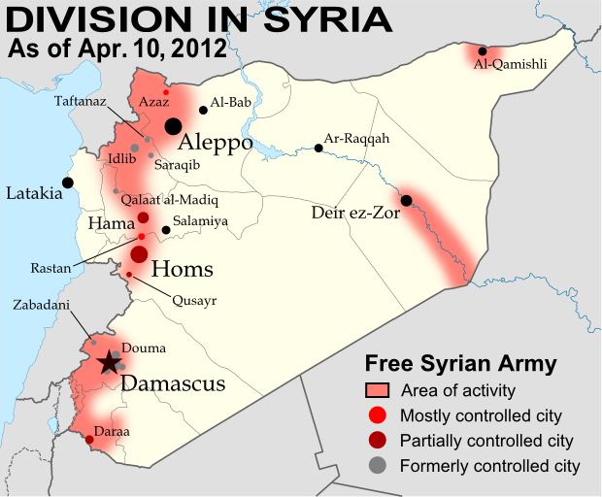
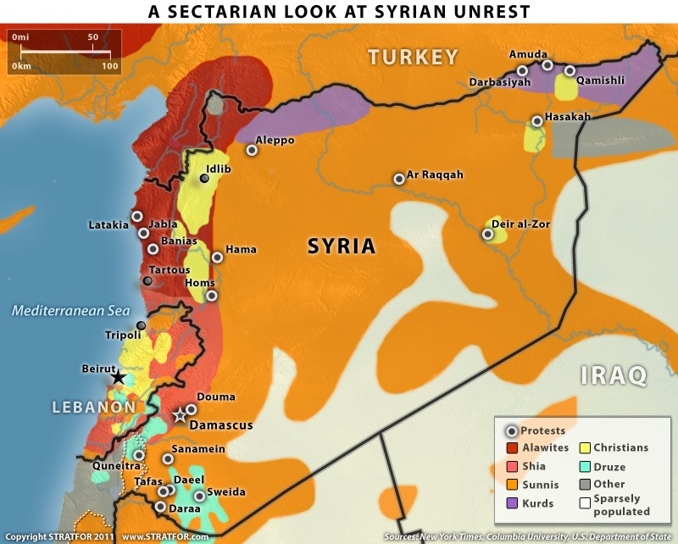
Syria – Strategic Analysis
Current political/ethnic/religious conflict
Political power divisions within Syria
Current Government – Bashar al Assad
Notes:
Current president – Bashar Al ASSAD

Slide 71
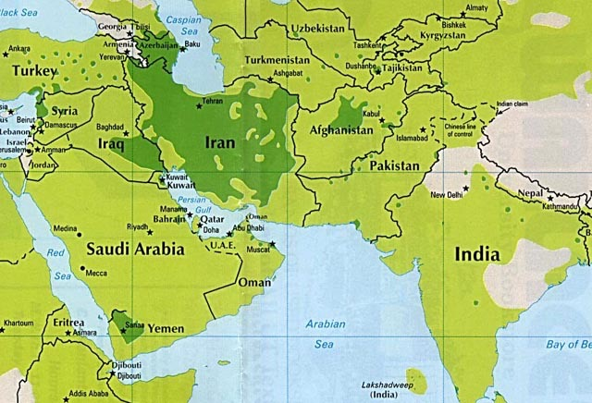
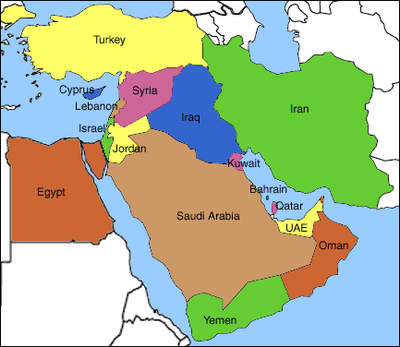
Syria’s Neighbours
Shia/Sunni, Spread of political Islam
Saudi Arabia/Turkey/Egypt/Lebanon
Israel/US and Western interests v. Russia/China (IRAN)
Extremists and Terrorists
Notes:
Sunni – Shiate split, Saudi Arabia Wahhabism spread. Lebanon

