Slide 1
Paper Expectations
PSY 475

Slide 2
Contents
What is your paper about?
What to include in your paper
The Rubric
How to Turn in your Paper
Peer Review Day
Due Dates

Slide 3
Any Questions?
Don’t forget about —
She can help with APA
Office hours Mondays from 1-3 in OMH 108
Utilize the Writing Center if you want someone to read through your whole paper. Only ask Haley specific questions, please.

Slide 4
What is your paper about?
Research grant proposal
Hypothetical, novel experiment of your choice
It must be new
You cannot redo someone else’s experiment
Think of a topic you’re interested in
Make an experiment from that
You will not be conducting data collection
Topic can be anything related to psychology
Your ultimate goal is to convince us to give you money

Slide 5
What to include in your paper
Cover Page
Background and Significance
Plan of Study
References
Budget
Appendices

Slide 6
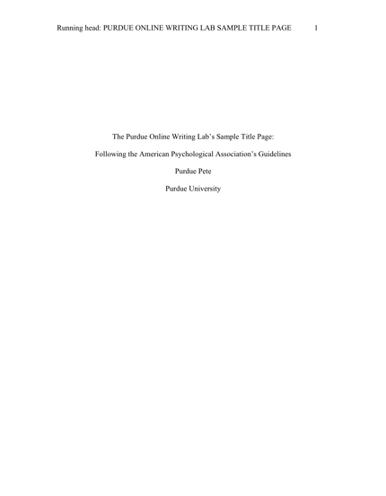
Cover Page (Title Page)
Follow the APA format for a research paper title page
Must fit on one page
Must include
Running head
Title
Your Name
Academic Affiliation
Draft

Slide 7
Background and Significance
Similar to the Introduction in a research paper
Review relevant literature to your topic
What have other scientists done?
What are results of similar studies?
What are you doing differently?
Why is your question important
State your hypothesis
6-8 pages
Must use citations

Slide 8
Plan of Study
Similar to the Methods and Results in a research paper
What is your experimental design
How will you analyse your results
Statistics!
What are your anticipated results?
What are possible flaws in your design and how would you fix them?
Provide multiple ways to conduct your study
Use future tense
Your study hasn’t happened yet!
4-6 Pages

Slide 9
References
Provide a reference section that starts on a new page from the rest of your body
Use APA style
Hanging indent
Double Spaced
Must have at least 10 peer reviewed references
You can have more!
Buzzfeed, IFLS, Facebook, and Wikipedia do not count as appropriate sources

Slide 10
Budget
1-3 pages
Prepare a realistic budget for supplies, technology, expert salary, etc. for your experiment
Remember, it’s hypothetical
You can spend whatever you want!
Just make sure the prices are accurate
Can be prepared in a list

Slide 11
Appendices
Any attachments relevant to the proposal
Assessment scales, questionnaires, stimuli, directions (verbal or printed)
Not required
A graph or a table representing your anticipated results is required
You must have at least one appendix

Slide 12
The Rubric APA Style (10 points)
Double spaced with 1” margins
12 pt font, times new roman
Running head with pagination
Appropriate title page
15 page minimum

Slide 13
The Rubric Assignment Submission (4 points)
On time
Printed (TWO COPIES)
In Class

Slide 14
The Rubric Cover Page (4 points)
Correct format
Includes Title Page

Slide 15
The Rubric Background and Significance (10 points)
Approximately 6-8 pages
Includes thesis statement
States relevant literature
Correct citations
Novel question

Slide 16
The Rubric Plan of Study (10 points)
4-6 pages
States experimental design
Includes IV and DV
Includes plan for analyzing data
Potential problems with design

Slide 17
Rubric Budget (4 Points)
1-3 Pages
Provides realistic budget
Includes budget for all parts of the proposed project

Slide 18
Other Considerations (10 Points)
Contains factual support for the purpose
Avoids ambiguity in discussion of methods, results or interpretations
Is clear and concise
Is developed logically
Main points are emphasized and auxiliary or background information is kept in proper perspective

Slide 19
References (14 points)
References on separate titled page (centered)
In correct APA format (all information included and appropriate for type of source)
Listed alphabetically
Hanging indent
Minimum of ten credible, accurate and appropriate sources
Each source is cited at least once and all cited sources are included in references
All citations complete and correctly applied

Slide 20
Style (8 points)
Academically appropriate (formal without being "wordy" or involving affectation (unnatural or artificial expression meant simply to impress)
Free of slang, contractions, personal pronouns, "you"
Variety of sentence structures
Fluency of expression in writing

Slide 21
Writing Mechanics (6 points)
Assignment is at least checked using word processing spelling and grammar tools
Assignment is also checked visually for errors not detected electronically
Syntax, grammar, spelling, punctuation, usage, mechanics, organization, and clarity are at the highest level

Slide 22
How to Turn in Your Paper
First Draft
PRINT out two copies
One with cover page, one without
Bring them to class and turn in
Do not turn them in via email or online
Final Draft
PRINT out one copy
With cover page
Bring it to class and turn in
Do not turn in via email or online

Slide 23
Peer Review Day
We will go through your proposals anonymously
I will hand out your paper to a random student to edit during class time
As an editor, you are asked to:
Check for grammar, spelling, mechanics
APA style
Clarity
This day will be worth 10 participation points, so try not to miss.

Slide 24
Draft Due Dates
Draft One due
You must turn in your first draft to turn in your second draft
Draft Two due

