Slide 1
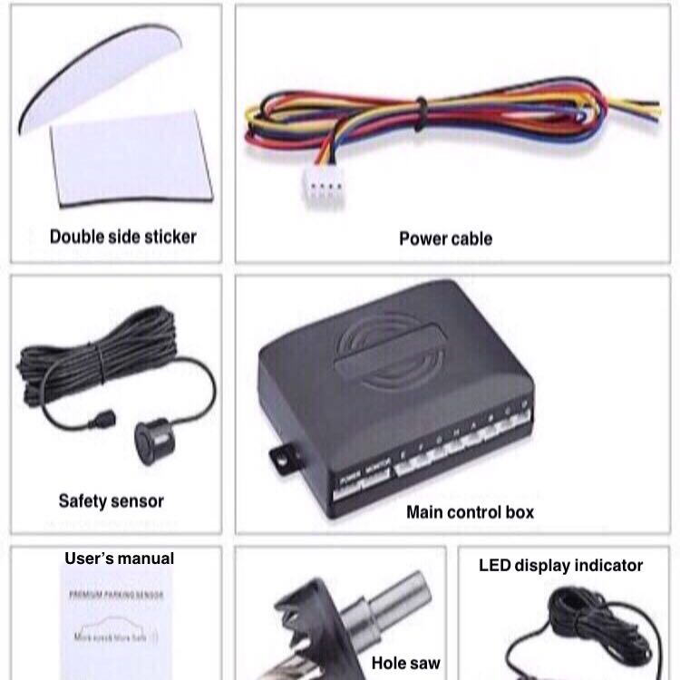
The Smart Wheelchair
Brief
• Designing an improved wheel chair suitable for outdoor use in hilly Yorkshire.
AIMS
• The aim of the project is to upgrade the wheel chair with new
attachments/supports that will make it suitable for rough surfaces, hills and
other similar terrains.
• Additionally, the new design is aimed to be lighter and more efficient than
normal wheelchairs.
OBJECTIVES
• The wheelchair to be designed must provide the maximum grip on hills and
other similar surfaces.
• the product has to be as light as possible to allow the ease of movability.
• Provide a better product for users that will allow go and explore new areas of
land which they were not able to go to before.
Meeting Customers’ requirements
•The new designed wheel chairs made to be more comfortable for daily uses especially for hilly Yorkshire.
•Easy to store and carry in the car as it can be fold or dismantled easily.
•Having a system recharge reminder that is connected to the users mobile phone or smartwatch.
•the new wheel chair with adjustable steering and control system will make customers comfortable
Support Wheel
Pros;
•The wheelchair will move faster because of the stronger battery.
•Automatic brakes help to stop the wheelchair from moving back in hills and to avoid accidents.
•Camber tires will help to keep the balance of the wheelchair.
• Safety sound sensors in order to give a sound-sign if there are obstacles on the road.
Battery
TASK
• Use a new efficient motor.
• Designing a new automatic break system.
• Produce 3D drawings of the improvements.
• Come up with a design for new wheels that can be changed or
added to make the chair more stable.
• Research how we can make the wheelchair better for hilly Yorkshire.
• Study the durability of other martials that can be used in building the chair instead of normal stainless steel.
• Using the lightest and most durable material to build the wheelchair.
• Designing 45 degree wheels to make the chair more stable on rough roads and hills.
• Design non-slip tiers from high quality rubber to ensure safety for users.
• Work on other improvements depending on customers' requirements
Cons:
•High speed may cause some harsh accidents.
•Higher battery power may consume a lot of voltages, and this will reflect on the wheelchair working hours.
•Increasing the battery voltage may cause some heat that may cause fire accidents.
Suggested Design for the camber Wheels
(Rguerz, 2016)
Key points of concept:
•The design has many upgraded features such as easy compatibility, smart charging system, stability, and an easy operating system.
•more durable battery.
•making the wheels at an angle (camber wheels).
•automatic break system.
References:
• https://m.ebay.co.uk/itm/Front-Rear-Car-Reverse-8-Parking-Sensors-Kit-Black-Buzzer-Alarm-System-Display/302413827251?_mwBanner=1
• https://grabcad.com/library/software/solidwork/tag/wheelchair
Automatic break system
(eBay, 2018)

