Slide 1
Introduction to the Study of Literature in English (ISLE)
Writing Assignment

Slide 2
Division of ISLE grades
Three components:
essay questions on written exam (12/20)
unannounced interim tests (3/20)
writing assignment (5/20)
As you progress in your academic studies, evaluations will take on more advanced written forms:
essay questions on exams
academic papers
BA and MA theses

Slide 3
Writing Assignment (cf. Blackboard)
Academic literature paper + list of works cited
Times New Roman, 12 pt, double spacing
Min. 1500 words - Max. 2000 words (excl. works cited)
Study Chapters 1, 3, 4, 5 & 6 from All Write (Acco)
Register, Argumentation, Structure, Sources, Writing
Deadline: 5 March 2018
=> hand in paper in class (stapled; no plastic folders please)
=> send digital copy to Hava Rosenberg (hava.rosenberg@uantwerpen.be)

Slide 4
Writing assignment in BA1
Learning outcomes:
consult academic sources and reference them correctly
develop ideas about a literary text, paying attention to various aspects
produce clear and coherent argument
English proficiency: formal, academic register

Slide 5
A Strong Literature Paper
Has a clear transparent structure
Introduction / Body / Conclusion
Is written in a formal register
Clear and correct language
Has well-structured paragraphs
Topic sentences and supporting arguments
Uses evidence from various sources
Primary and secondary
Cites the information properly
In-text + bibliography (MLA guidelines)

Slide 6
A Strong Literature Paper
Has something to say
Don’t state the obvious (more analysis than summary)
Is convincing
Use evidence and counter-examples (which it refutes)
Is clear
Easy to read and does not make the reader work hard
Is focused
Stick to the point and answer the research question
Is correct
Respect rules; make no mistakes (grammar, spelling, punctuation)

Slide 7
A Strong Literature Paper
Requires:
thought, effort, hard work
days/weeks, not hours
Are rewarded with:
appreciation, respect, high marks
more insight, better reading and writing skills
Difficult at first but becomes easier with time and practice.
If you take paper writing seriously and are self-critical.

Slide 8
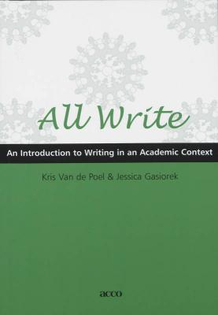
Evaluation criteria
language (spelling & grammar)
style (register & clarity)
structure (sentence & paragraph)
content (depth & originality)
sources (quality, citations & works cited)
Using the All Write scale (cf. Blackboard)
Grades will appear on Blackboard
Feedback

Slide 9
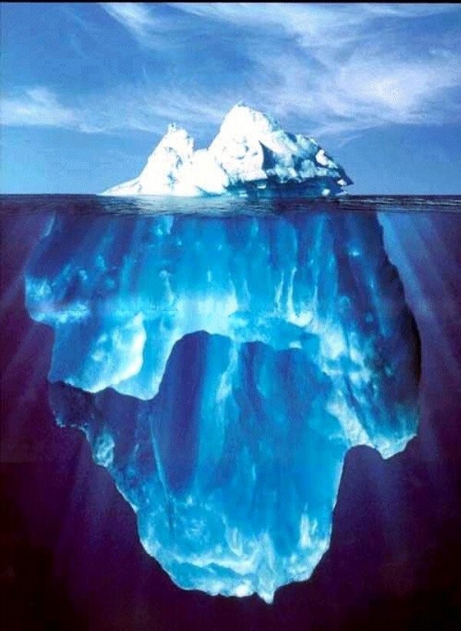
“Hills Like White Elephants”
Hemingway’s famous Iceberg Principle / Theory of Omission
“I always try to write on the principle of the iceberg. There is seven-eights of it under water for every part that shows. Anything you know you can eliminate and it only strengthens your iceberg.” (Interview by George Plimpton, Paris Review)
Important aspects of the story are left out
Need to be inferred by reader (textual ‘clues’)
Dialogue
Symbols (e.g. surrounding)
Modernist writer: reader has to work!

Slide 10
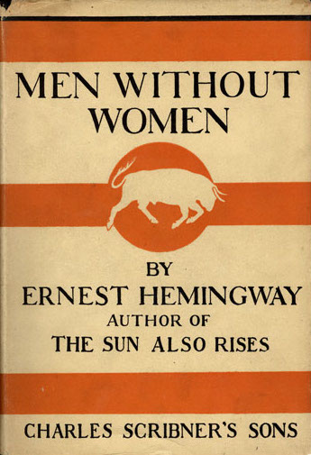
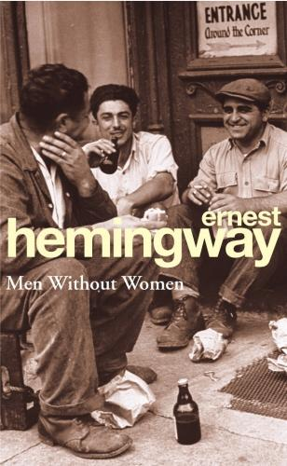
“Hills Like White Elephants”
Ending of “Hills Like White Elephants”
Will the girl (Jig) have the abortion or not?
Will the couple’s relationship last or not?
How did you come to your conclusion?
Thesis statement!

Slide 11
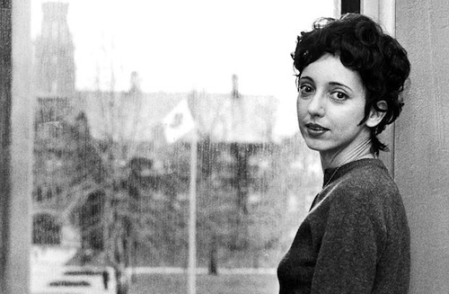
Alternative assignment
Joyce Carol Oates (°1938)
“Where Are You Going, Where Have You Been?” (1966)
Instructions and research question on Blackboard

Slide 12
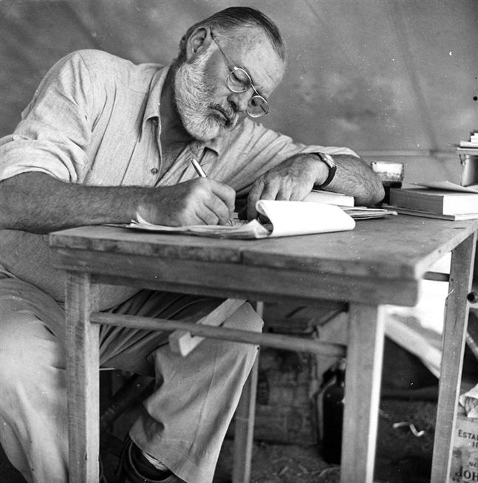
Research
A minimum of 3 scholarly sources:
1 academic journal article (Hemingway Review)
1 monograph (book written by one critic)
1 chapter from an edited volume (= a book
that brings together work by several critics)
Specifically on Ernest Hemingway
In English!
Look them up:
In the UA library catalogue
In academic databases (Project MUSE, MLA international bibliography)
No Google, Wikipedia, SparkNotes, eNotes, BookRags, etc.

Slide 13
Academic Writing - Register
Informal vs. formal writing
Crucial question: Who is your audience?
Not: the general public, your fellow students/friends
But: someone who
is (professionally) interested in literature
has an advanced understanding of English
is experienced in reading secondary literature
Knowing your audience will increase your impact!

Slide 14
Academic Writing - Register
(Informal)
Formal
High School / Blog / Diary
Personal / Informal / Casual
Appreciation (taste, preference)
Personal reflections / Questions
Colourful, vibrant layout
Poetic language / metaphors
Shows appreciation or dislike
University / Edited Prose/ Media
Distant / Formal / Respectful
Analysis (mostly reason, intellect)
Mostly declarative statements
Plain, unobtrusive layout
Clear language / examples
Shows understanding and insight

Slide 15
Academic Writing
Academic writing = clear and argumentative writing
It wants to prove a point (thesis)
Not by using forceful language (statements) or intuitive claims
But by being reasonable and persuasive (arguments)
Thesis statement = essential
Preferably one (or two) simple declarative sentence(s)
Must be debatable (not obvious or impossible)
If everyone agrees, there is no point in proving it…

Slide 16
Writing Process (I think / They say / I say)
Reflection
result = thesis statement
Brainstorming
clustering information and selecting material
Support
look up useful secondary sources => return to thesis statement
Organizing
draft structure of argument (outline / schedule)
write the intro > the body > and the conclusion
First draft
wait a day or two > you need a fresh pair of eyes
Revision
by you or a peer > revise on paper to avoid getting used to the screen
Final draft
run a final spelling and grammar check

Slide 17
Brainstorming / Organizing
Getting yourself organized (All Write pp. 36-37)
Make a list of ideas related to your thesis (word doc / cards)
Draw connections between them (tree/web)
Cluster information (colours/categories/labels)
= topic sentences of paragraphs
Strike out what doesn’t fit (organize/structure)
Think of counter-arguments and refutations

Slide 18
Finding Sources
Three good search strategies
UA library catalogue (books)
MLA database (articles) / J-stor / Project Muse
Bibliography “snowball method” (books and articles)
Use the UA library facilities, not to the internet
Internet sources are not always reliable (unprofessional)
Academic books and journals are peer reviewed
Be careful with online versions of articles / primary texts
Errors / Incomplete / Copyright infringement
Always look up original source (or pdf)

Slide 19
UA Library Catalogue
Go to the UA library website
Click ‘My Library’
Click tab “Advanced search” (3rd top)
Enter “Hemingway” as Search Term
Select “Title word” as Search Index
Select “English” as Language
Select “Paper” as Material Type
Select “UA-Stadscampus” as Library
Click “Start” (top left of page, under the tabs)
You will now see all books on Ernest Hemingway

Slide 20
UA Library Catalogue
Click on any title that seems interesting
e.g. New Essays on Hemingway’s Short Fiction (Paul Smith)
Go to the “Availability” section (bottom)
Click “UA – Bibliotheek Stadscampus”
Write down signature: e.g. T&L 820.73 N-HEMI-SMIT 98
Check availability
Look it up in the library (most on same shelf, not all!)
Ask assistance if you can’t find it
Consult or make copies, but don’t take it home!!!
Other students need the material as well…

Slide 21
MLA International Bibliography
Go to the UA library website
You need to do this from a UA computer (intranet)
Or from home by using a VPN connection (login > click “Library”)
Click “Databases (articles)” under “Search”
Click “MLA international bibliography”
Click “Advanced search”
Enter “Hemingway” in the first search box
Enter the title of your story in the second search box
Click “Search”
Some articles are available in pdf from the database
Look up others in the UA catalogue (see before)

Slide 22
Project MUSE
Go to the UA library website
You need to do this from a UA computer (intranet)
Or from home by using a VPN connection (login > click “Library”)
Click “Databases (articles)” under “Search”
Click “Project MUSE”
Click “Advanced search”
Enter “Hemingway” in the first search box
Enter the title of your story in the second search box
Click “Search”
Some articles are available in pdf from the database
Look up others in the UA catalogue (see before)

Slide 23
“Snowball” Method
Find a very recent article/book chapter on your story
Check its bibliography
Identify the most relevant sources
This is an easy way to find relevant sources quickly
Look up useful entries in the UA library catalogue
A combination of strategies offers the most success
It’s all in an afternoon’s work at the library…

Slide 24
Other Electronic Sources
Articles on various websites
“Bootleg” versions of print articles, student or amateur papers
No peer review (errors of all kinds)
Often unprofessional and unreliable
http://caffeinatedmusic.wordpress.com/2011/05/10/analysis-of-hemingways-hills-like-white-elephants/
http://jncoppock.tripod.com/id18.html
Usually these are unreliable sources, so don’t use them…

Slide 25
Paper Outline (All Write pp. 54-57)
Title
Subtitle
Introduction
Hook + Background + Thesis statement
Body
Paragraphs
Topic sentence + Supporting evidence
Conclusion
Restatement of argument + Main points + Closing thoughts
Bibliography
List of sources (MLA guidelines)

Slide 26
Titles
Titles
Are relatively short and always capitalized
Capture the essence of a text (cf. summary/abstract)
Identify the focus and the topic (link with thesis)
Draw the reader’s attention
Usually mention title of work and/or name of author
provides the reader with the necessary orientation
e.g. “Spectres of Thatcherism: Contemporary British Culture in J.K. Rowling’s Harry Potter series” (Karin Westman)
The importance of titles is often underestimated by students and academics alike! (narrow down/specify)

Slide 27
Introduction
Hook
Anecdote or pertinent fact related to your thesis
Draws your reader into the text
Usually one or two sentences
Background information
Explains significance of anecdote
Often includes story title, author’s name, and short summary
Usually no more than four or five sentences
Thesis statement
Clearly stated point that you are going to argue or prove
Preferably one (or two) sentence(s)
Position: between middle of page one and two

Slide 28
Body
Paragraphs
Self-contained units (cf. intro / body / conclusion)
Contain one, and only one main idea related to thesis
Topic sentence > Supporting evidence > Conclusion (analysis!)
Sentences and paragraphs follow logically from each other
Linking words (cf. All Write p. 53)
Templates (cf. They Say/I Say p. 221-235) > Blackboard
Draws on sources
Primary (story) and Secondary (articles/books)
Paraphrases, quotations, insights, examples, descriptions, etc.
In-text citations (MLA guidelines)

Slide 29
Supporting your Argument
It is not enough to simply state your opinion
Opinions need arguments
Arguments need support
≠ generally held beliefs (you, family, friends, society, etc.)
But specific evidence from traceable sources
Sources are always paraphrased or quoted (in-text citations)
Following certain conventions and rules (MLA)
PLAGIARISM (Video)
Don’t present other people’s exact or slightly modified words as your own (ZERO!)
Remember: a text without good support is a weak text!

Slide 30
In-Text Citations
Quotes
Copy an author’s exact words into your text
Enclosed in quotation marks (“…”)
Should be indented en bloc when longer than three lines
Without quotation marks, preceded and followed by a blank line
Paraphrases
Rewrite a source text in different words (cf. summary)
Convey the author’s most important insights
Are usually shorter than the source text
Both are followed by a citation!
Refers to original source (cf. list of works cited)
Uses Modern Language Association (MLA) conventions (Name page).

Slide 31
Embedding
When you embed a quote or paraphrase you
Incorporate it into your sentence grammatically
e.g. by using a colon (:) or a comma (,)
As Oakland writes in British Civilization, “xxxxxxxxxxx” (65).
Introduce and situate it within the context of your argument
Explain its purpose or relevance to your reader
Also make sure that your quotes and paraphrases add value
They should not merely repeat what you have just said (or vice versa)
But illustrate points or introduce opinions you (dis)agree with
Don’t cite extra sources just to meet your quota (it shows)
Reading sources thoroughly makes you a better quoter!

Slide 32
Conclusion
Last paragraph
Should leave a strong impression
Restates the argument (cf. thesis)
Usually summarizes the major points (not all)
Draws a final conclusion
Don’t
Introduce new ideas concepts that need explanation
End with a quote (be original)
Discourage or dismiss your own interpretation
End on a vague note (‘closure’)

Slide 33
Sources
List of works cited
Only mention those that are cited in your paper! (≠ Bibliography)
Leave out those that you have read but did not use…
Include both primary and secondary sources in one list
Are alphabetically arranged by author’s last name
Follow only the MLA guidelines

Slide 34
Monographs
Monographs are usually written by one author
As opposed to essay collections => several authors, one editor
They are the easiest sources to list
Giger, Romeo. The Creative Void: Hemingway’s Iceberg Theory. Francke, 1977.
Gurko, Leo. Ernest Hemingway and the Pursuit of Heroism. Crowell, 1968.
Note that titles are always capitalized and italicized.
Whenever a colon separates title and subtitle, use a capital

Slide 35
Edited Volumes
Chapters from an anthology require more information
Refer to and list under the author’s name, not the editor’s
Hoffman, Stephen K. “Nada and the Clean, Well-Lighted Place: The Unity of Hemingway’s Short Fiction.” New Critical Approaches to the Short Stories of Ernest Hemingway, edited by Jackson J. Benson, Duke UP, 1990, pp. 172-191.
Sanderson, Rena. “Hemingway and Gender History.” The Cambridge Companion to Hemingway, edited by Scott Donaldson, Cambridge UP, 1999, pp. 170-196.
Never italicize chapter titles (italics are only used for book titles), but put them between quotation marks
Capitalize subtitles after a colon and

Slide 36
Short Stories
The same rules apply to short stories
Hemingway, Ernest. “Hills Like White Elephants.” The Short Stories, Scribner, 1997, pp. 251-255.
Make sure to place the full stop inside the double quotation marks
Never italicize the title of a story

Slide 37
Articles
Articles in periodicals (journals) are rendered as follows:
Benert, Annette. “Survival Through Irony: Hemingway’s ‘A Clean, Well-Lighted Place.’” Studies in Short Fiction, vol. 11, no. 2, 1972, pp. 181-187.
Renner, Stanley. “Moving to the Girl’s Side of ‘Hills Like White Elephants.’” The Hemingway Review, vol. 15, no.1, 1995, pp. 27-41.
If you use a digital copy, add the name of the database and hyperlink:
Golman, Anne. “Questions of Transport: Reading Primo Levi Reading Dante.” The Georgia Review, vol. 64, no. 1, 2010, pp 69-88. JSTOR, www. Jstor/org/stable/41403188.
Use double quotation marks for chapter titles and single quotation marks for titles of stories in chapter titles
Mention volume, number and pagination for every article

Slide 38
Sample papers (MLA format)
See https://style.mla.org/sample-papers/
In particular:
https://style.mla.org/files/2016/10/mla-sample-paper-fourth-year.pdf

Slide 39
Good Luck!

